Slide 1

Tablet Restaurant Application
Goutham Narendiran, 100556439
Vipooshan Sivaruban, 100618301
Sajeeva Seralathan, 100586578

Slide 2

Introduction
Tablet installed for each table permanently helps in the increase of customer orders
Customers are able to read/write their opinion under any dish
This tablet restaurant application will send customer orders straight to the kitchen without wait time.
Changes to menus can be made simply by updating the application without any consequences

Slide 3

Objective
Save money on staffing
Update menu application without consequences
shorten order taking and processing time
Customers will be able to read and write reviews about dishes

Slide 4
Measure of Success
Meet deadlines
Satisfy client requirements and needs
Finished within agreed upon timeframe
With minimal to no bugs
Successful implementation on test subject
Good market survey result
75% or greater interest rating from market is target

Slide 5
Risks
Risks
Countermeasures
Market Competition: Since this project will take an estimated 22 months, there is a high chance someone else may beat us to the market.
Market Adaptation: Humans do not like change, it may be a challenge to get users to adapt to screens rather than waiters
Operation Risks: Technology is not bulletproof. We must ensure that the system will not affect the restaurant’s ability to earn in a negative way.
Longevity and Maintenance: We must ensure that the software is not going to malfunction in the future after its’ Software Support period.
Present to possible clients and secure their commitment with a lower initial offering price and a deposit.
Start marketing campaign prior to integration to get restaurant’s clientele familiar with the change prior to the change.
Rigorously test the system prior to finishing integration for all possible situations. Have back up hardware ready to use at a moment’s notice. Have a back up method for complete down time.
Extensive and rigorous testing and extended warranty for client’s peace of mind.

Slide 6
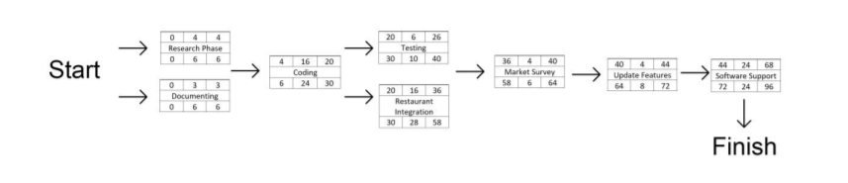
Activity Network Diagram

Slide 7
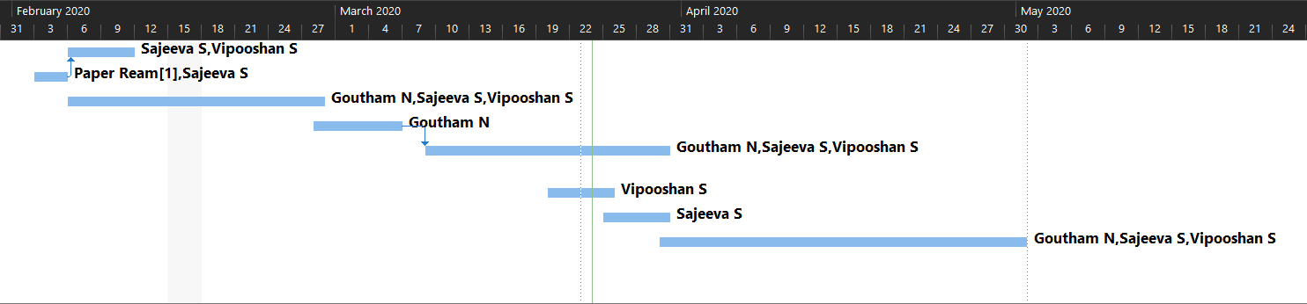
Gantt Chart

Slide 8
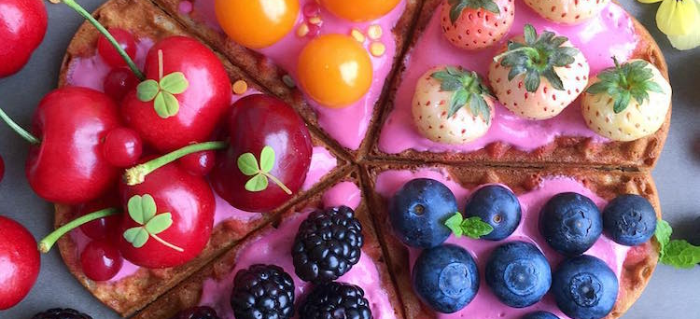
Thank You
Thank You

